Slide 1

Hungry Slugs
Team Members:
Ian Holloway (Product Owner)
Akhil Senthil, Akshat Tiwari, Anya Zhang, and Noah Kim (Devs)

Slide 2
Hungry Slugs
Problem:
The current UCSC dining hall website does not give users insight into the quality of the food served.
UCSC dining customers can’t voice their opinions on the food they are served.
Intended Users:
UCSC students and other customers.
Anyone visiting the UCSC campus looking to try the food.

Slide 3
Project Scope
Display foods available at each dining location
Users can rate each dish on the menus, as well as post comments.
Users can choose to get notified when foods they’ve rated 5/5 is available at a dining location.
Users can search for available foods based on name and dietary restrictions/preferences.

Slide 4
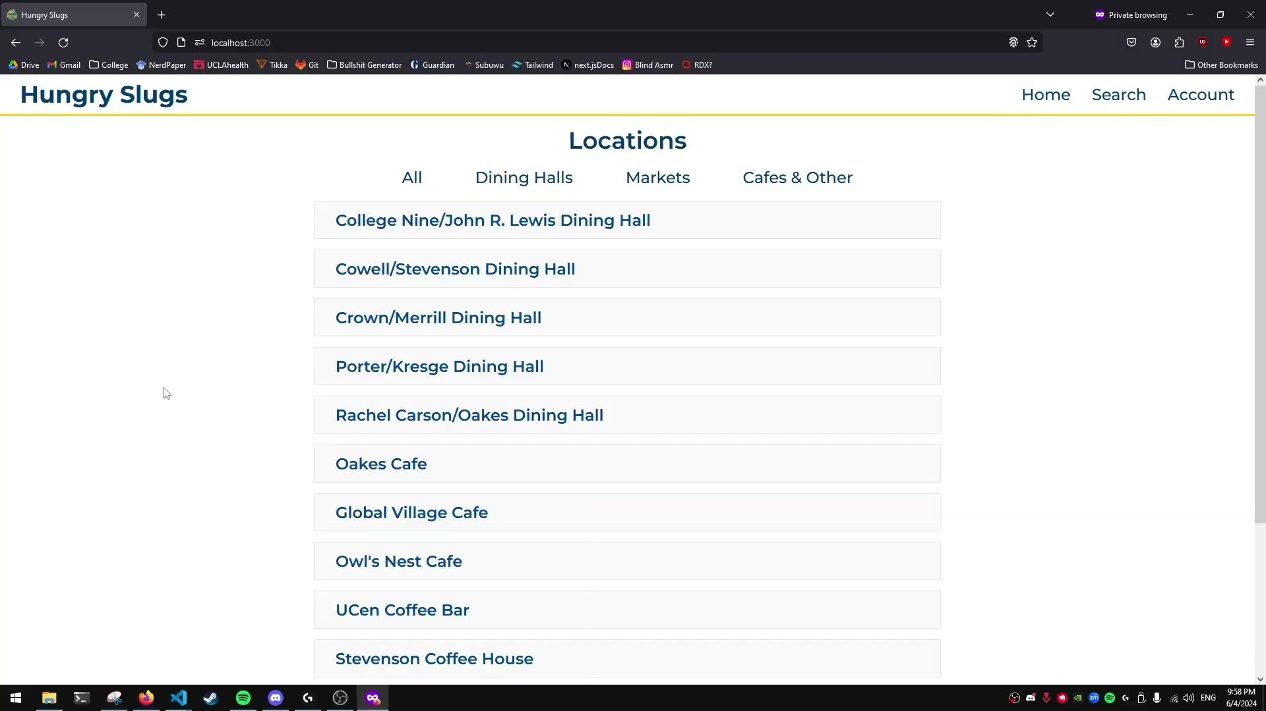
Demo

Slide 5
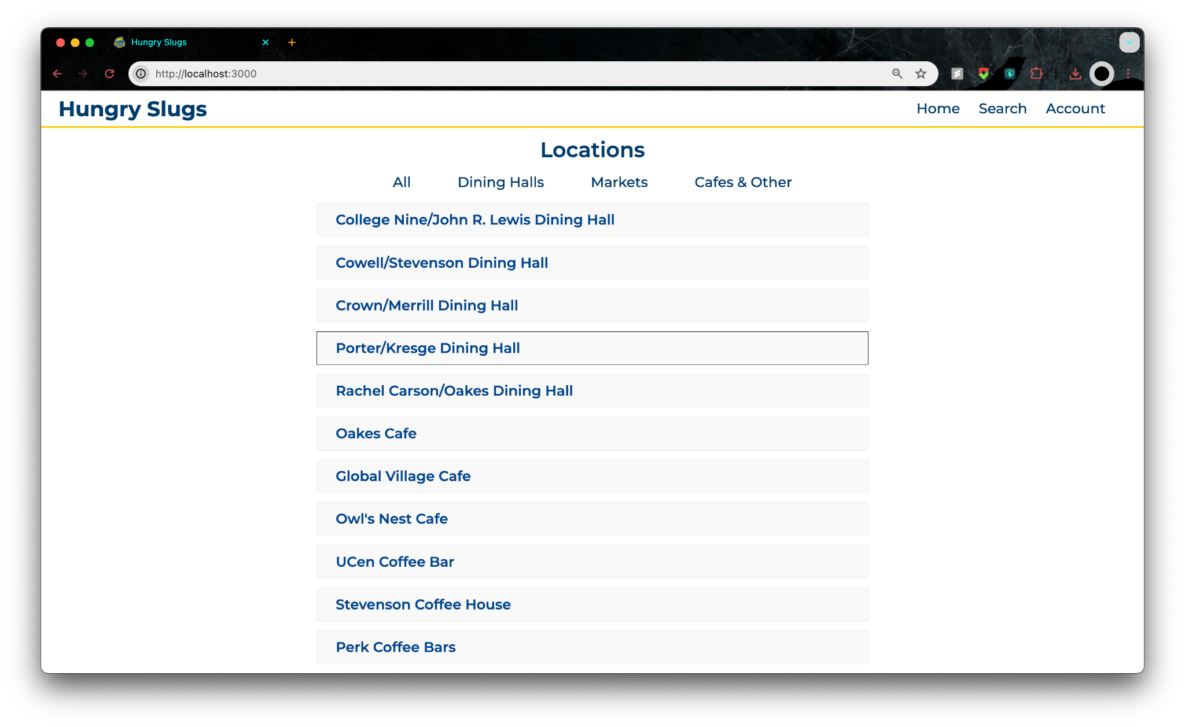
Screenshots

Slide 6
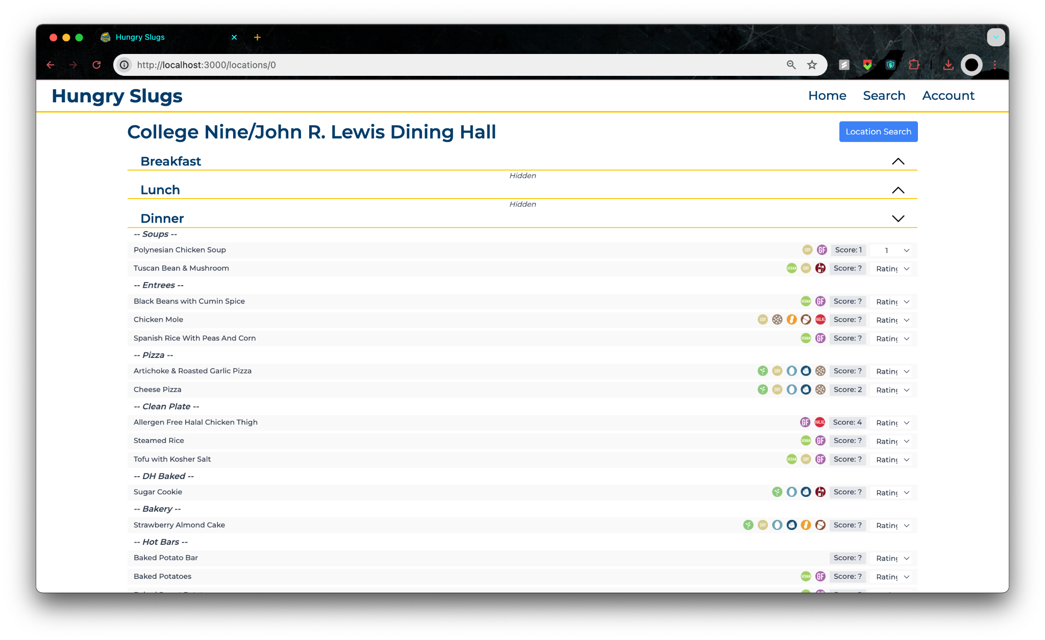
Screenshots

Slide 7
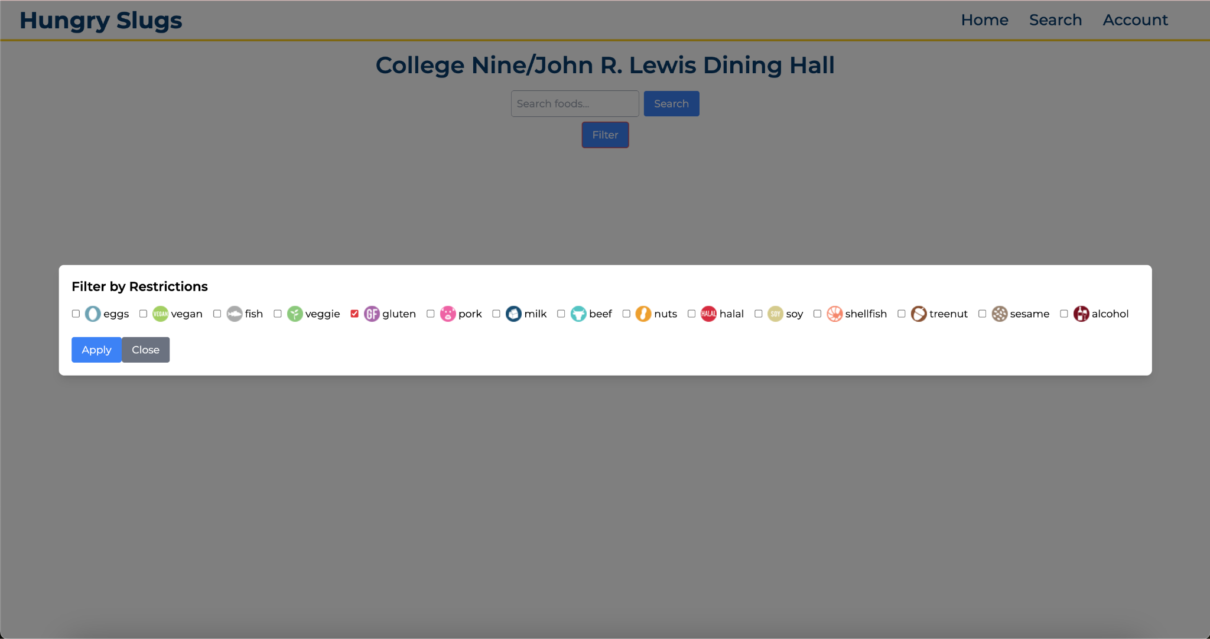
Screenshots

Slide 8
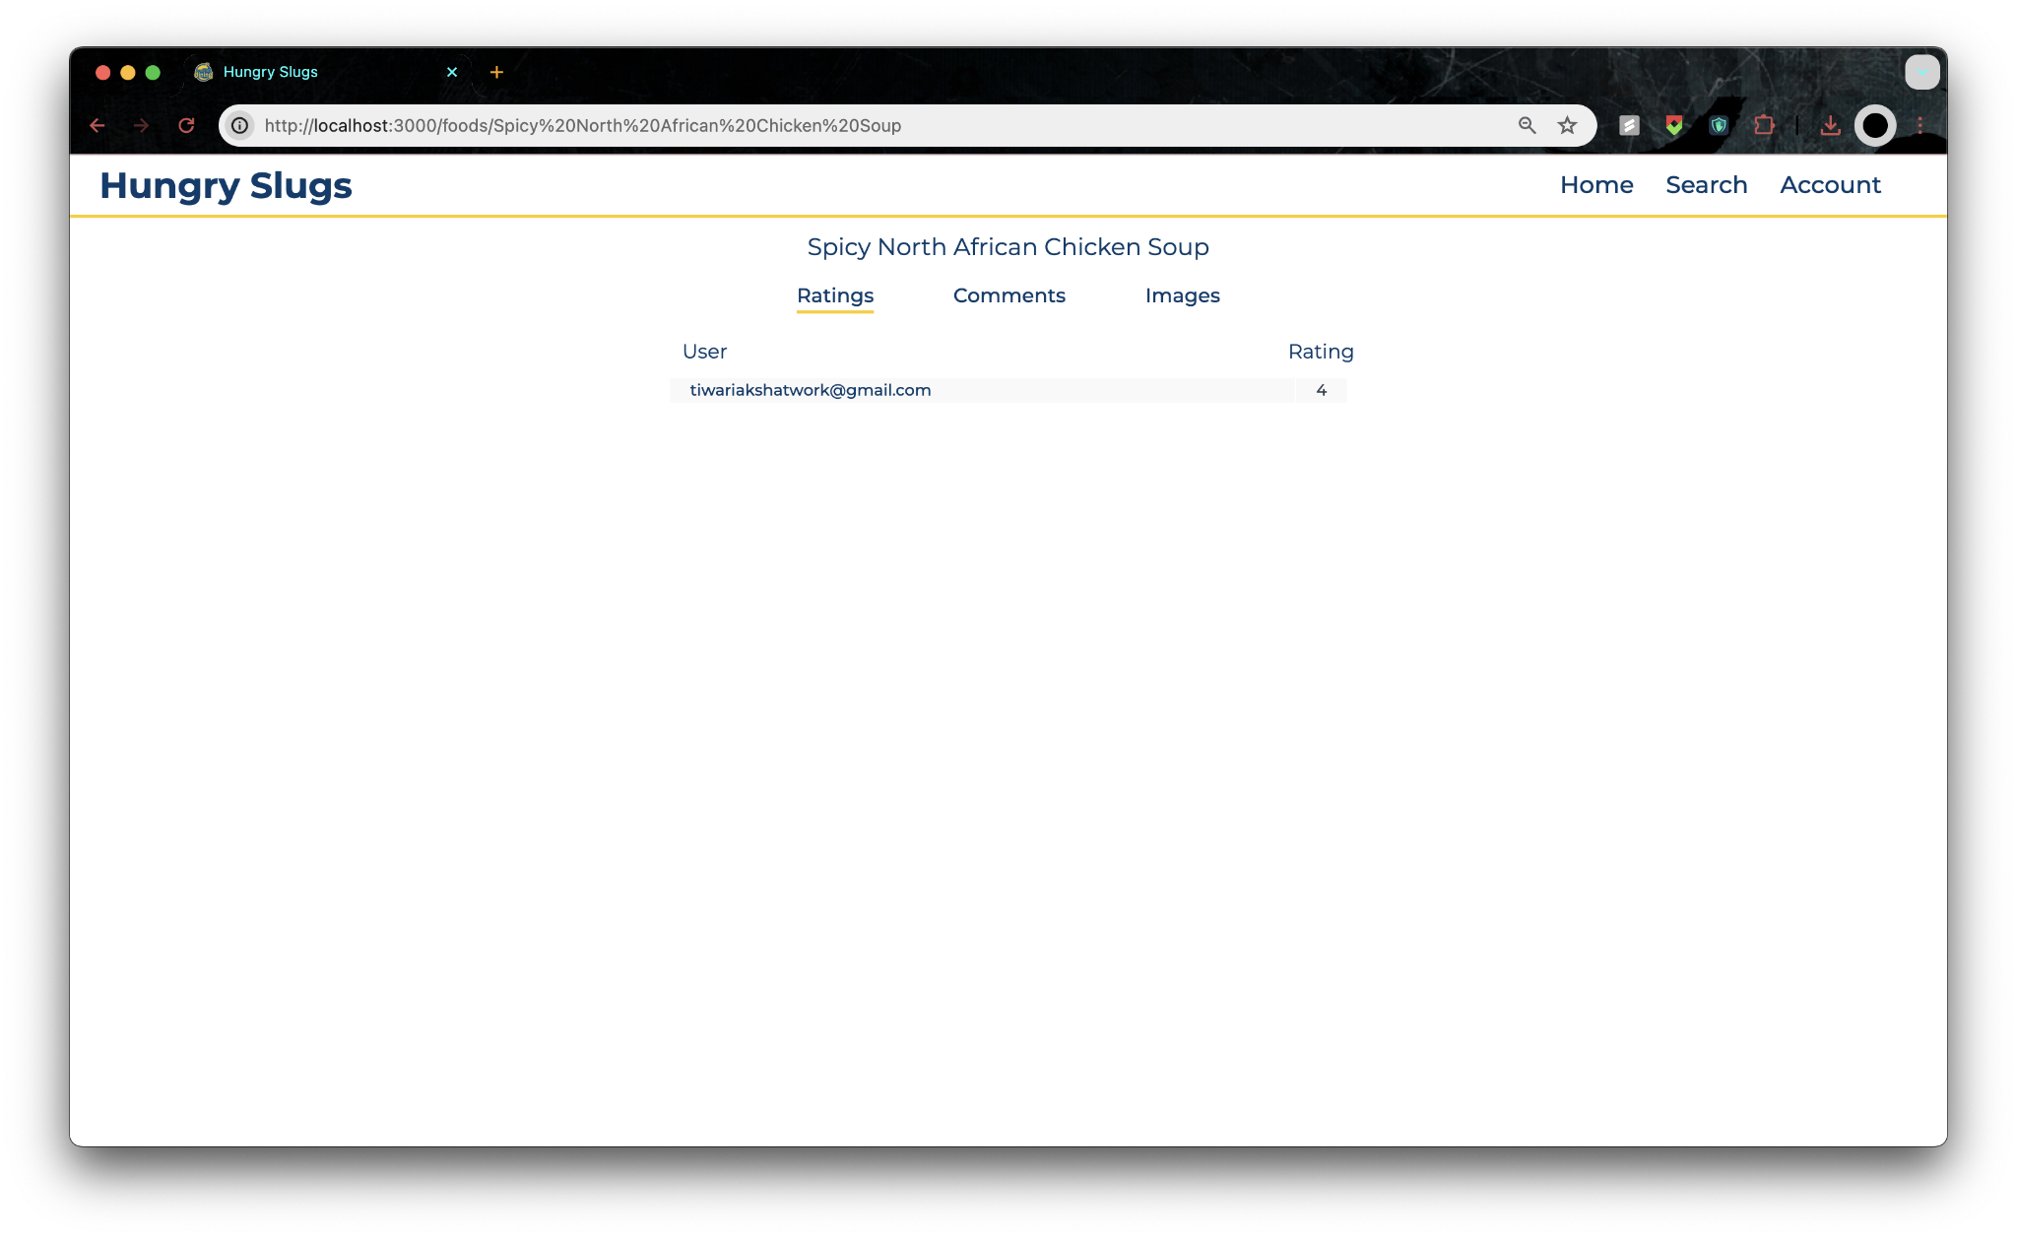
Screenshots

Slide 9
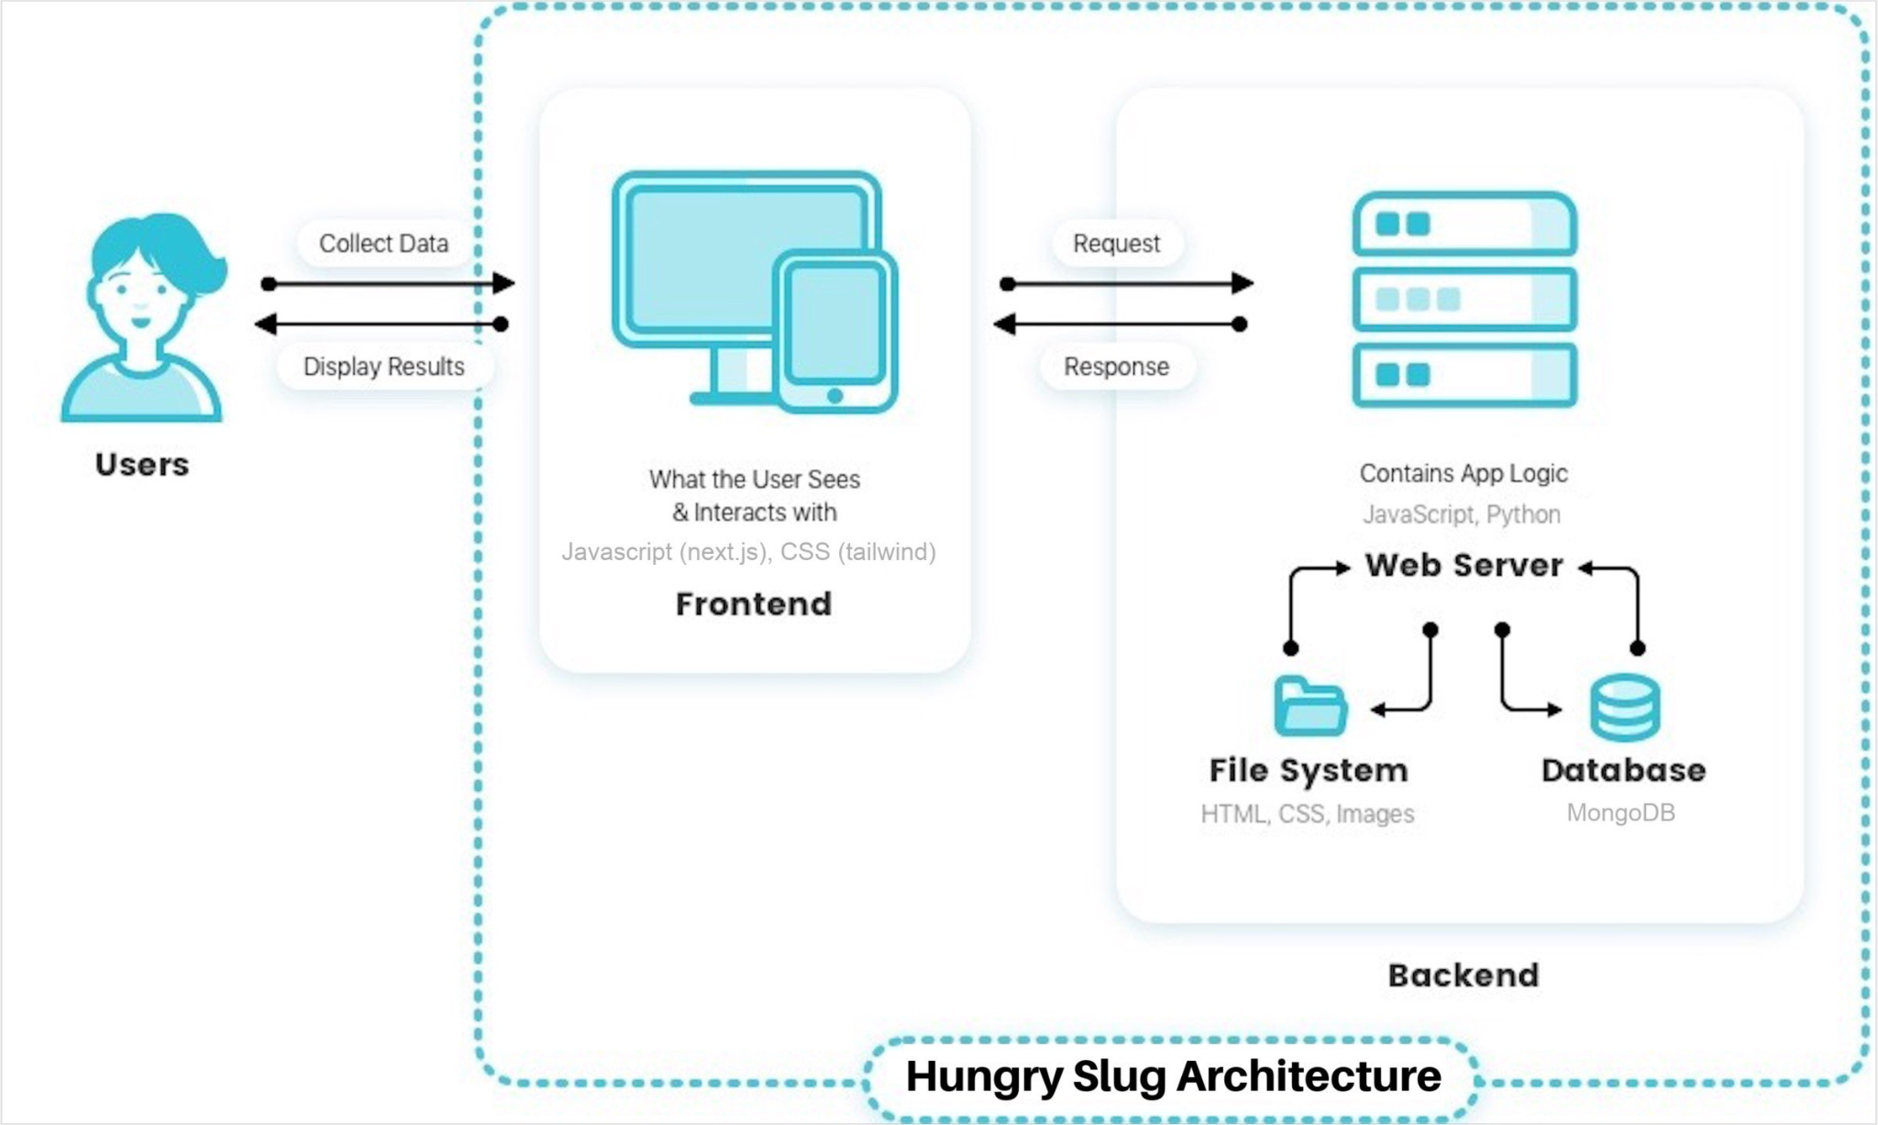
System Overview
Notes:
Anya: user interacts with the user interface on the frontend (next.js)
the frontend communicates with the backend (django) which saves data inside the database (mongoDB)

Slide 10




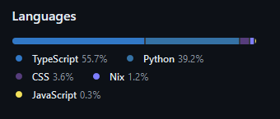





Technologies
Front-end
Next.js
Tailwind CSS
React
Axios
TypeScript
OAuth
Prettier
Figma
Back-end
Django
Django Cors Headers
Django Rest Framework
MongoDB
PyMongo
BeautifulSoup
DevOps
Github
Google Drive
Discord
Nix Environment Shells
Notes:
Anya: mention next.js with tailwind css for frontend ui, axios for sending post requests, django for backend with mongodb database, beautiful soup for web scraper,

Slide 11
Project Management
Scrum Framework
Scrum Meetings
Scrum Roles
Discord - Communicate
Github - Manage Tasks & Issues
Google Drive - Documents

Slide 12
Retrospective Thoughts
Enjoyed:
Learning to use new technologies
Building something for the UCSC community
Creating a project in a team environment
Didn’t Enjoy:
Scheduling conflicts
Differing levels in quality of tasks
Flaccid Scrum

Slide 13
Challenges
Product Features:
Uploading images proved to be more difficult than expected
Login and authentication process for users
Developmental Process:
Learning to develop with new technologies
Balancing writing the most efficient solutions vs getting task done in a timely manner.
Getting everyone on the same page for developmental practices.

Slide 14
Lessons Learned
Tasks are less likely to be done without consistent team check-ins.
The estimated time to finish a task is hardly ever accurate.
Some tasks cannot be completed without a significant amount of research.

Slide 15
Thank You
Questions?

